Slide 1

"TechForing Growth" Software Launch

Slide 2

Introduction
In this era of automation, people are benefiting from various innovative applications that offer simple solutions to complex issues.
This presentation covers a brand-new software named “TechForing Growth” launching by TechForing, which designed to simplify every aspect of employee lifecycle management, from recruitment and onboarding to performance evaluation and finance, our platform empowers HR teams to work efficiently and make data-driven decisions using AI.
Whether it's a growing business or an established organization, our software adapts to your needs, ensuring accuracy, security, and scalability.
Introduction
Recruitment
HRMS
Finance
Development Background
USP &CAC
Conclusion
2 of 20

Slide 3
Introduction- Three Main Modules
Recruitment
HRMS (Human Resource Management System)
Finance App
Introduction
Recruitment
HRMS
Finance
Development Background
USP &CAC
Conclusion
3 of 20

Slide 4

Recruitment
The main objective of the recruitment process is to choose the right person for the right position. Major features of our recruitment system that work together to help identify the best candidate for the open role.
Job Description for the Proposed Position
Online Job Posting
Receiving Job Applications
Resume Parsing
Candidate Vetting
Introduction
Recruitment
HRMS
Finance
Development Background
USP &CAC
Conclusion
4 of 20

Slide 5
Recruitment- Major Features
Job Description
Candidate Database
Interview Scheduling
Notifications and Alerts
Offer Letters
On Boarding
Job Applications
Resume Parsing
Online Job Posting
Candidate Vatting
Interview Scheduling of the Short-listed Candidates
Notification and Alerts
Offer Letters for the Finally Selected Candidates
Onboarding New Talent
Storing Candidate Data
Recruitment System at a Glance
Introduction
Recruitment
HRMS
Finance
Development Background
USP &CAC
Conclusion
5 of 20

Slide 6

HRMS
An HR software with integrated modules can automate many of the processes that consume the bulk of your HR department’s time. TechForing’s skilled professionals develop automated tools to reduce the need for manual data input, eliminating the risk of errors while saving time and resources. Our HR system includes multiple HR modules.
Attendance and Leave- Over the years, the demand for leave and attendance management systems has constantly increased while the key benefits are Improved Efficiency, Cost Reduction, Reporting and Analysis.
Performance Management- This module automates the performance review process, tracks personal goals and company KPIs and as well as manages completed training and certification programs.
Introduction
Recruitment
HRMS
Finance
Development Background
USP &CAC
Conclusion
6 of 20

Slide 7

HRMS- Major Features
Off Time Tracking- This is a key module to help automate how time off is allocated, booked, approved and monitored for any type of absence in your organization.
Training and Learning Management- Our learning management module allows HR to provide and track training completions and certifications for compliance. Required training, like OSHA regulations, safety, leadership, ethics and more training compliance can be assigned and accessed through the employee portal, 24/7.
Benefit Management- Benefits are a key factor in employee engagement, recruitment and retention, and they demonstrate that the company cares about its employees. Benefits influence morale, productivity, and employee retention.
Introduction
Recruitment
HRMS
Finance
Development Background
USP &CAC
Conclusion
7 of 20

Slide 8

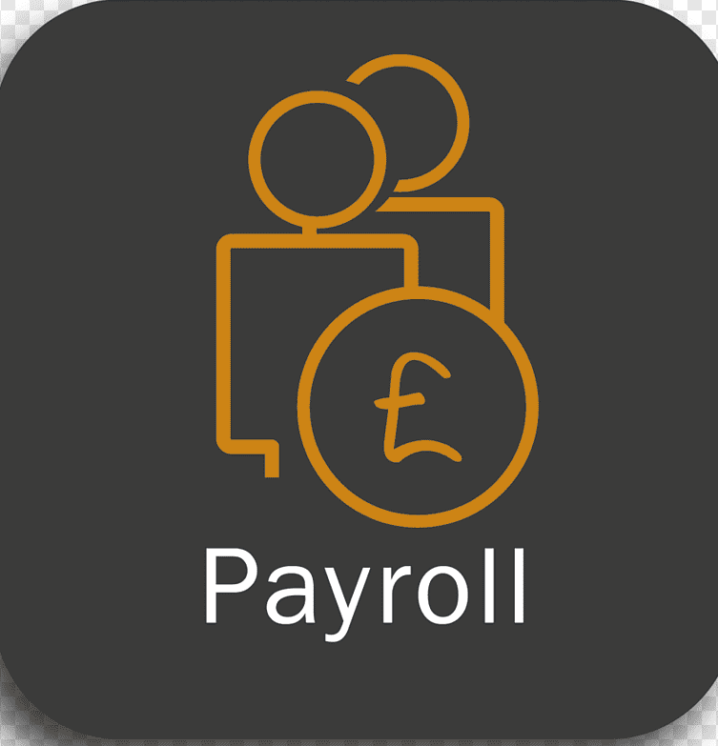


Finance
Our advanced financial management system is the best methodology that an organization uses to oversee and govern its income, expenses, and assets with the objectives of maximizing profits and ensuring sustainability. It includes various financial processes such as: budgeting, accounting, payroll, and financial reporting.
Bugeting
Payroll
Accounting & Cash flow
Sales
Introduction
Recruitment
HRMS
Finance
Development Background
USP &CAC
Conclusion
8 of 20

Slide 9
Finance- Key Features
Budgeting- The TechForing Growth application is designed to fit all types of business budgets, enabling top management to stay on top of all financial aspects. Key elements of our budget modules are Budget Rational, Performance Metrics, Analysis and Reporting.
Payroll- Our payroll module automates the management of employee payments, including wage calculations, managing employee timecards, loan adjustment, tax deduction, and compliance with tax laws. Besides, our software support multiple currencies which is vital for many organizations.
Sales- Organizations spend a lot of resources on maximizing their sales performance. The right sales software provides your organization with sales tools that can significantly increase selling. Our precise sales module improves sales performance, enhances decision-making, informs sales strategy and provide data driven decision
Cash Flow- Our modern accounting software includes more advanced features, like advanced analytics, automated billing and invoicing, and multi-currency. Integrated cash flow management involves monitoring, analyzing, and optimizing the movement of cash into and out of a business to ensure financial stability and efficiency.
Introduction
Recruitment
HRMS
Finance
Development Background
USP &CAC
Conclusion

Slide 10
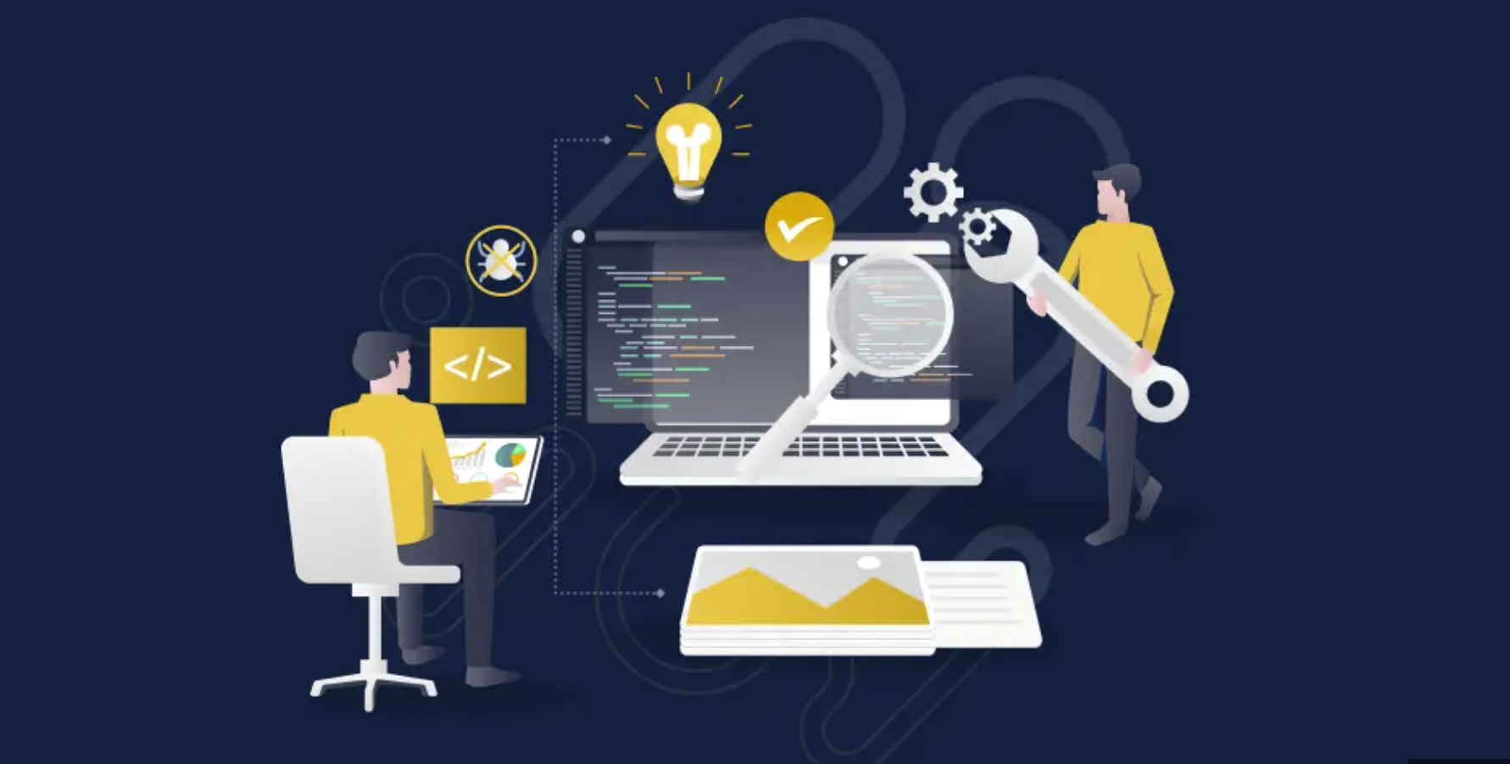
Development Background
Let us have a glimpse of development background. Our professional software development team plans, creates, tests, and releases new software and modules. Each role collaborates with others to ensure all tasks are completed according to stakeholders' expectations and released on time. Followings are three major components related to software development.
Time Frame
Expense Breakdown
Team Building
Introduction
Recruitment
HRMS
Finance
Development Background
USP &CAC
Conclusion
10 of 20

Slide 11
Development Background- Team Building
Our high-performing software development team is a well-rounded unit armed with all required technical and project management expertise to deliver a software solution more quickly, securely, and reliably. This affects the performance of a business in terms of measuring software developer productivity and drives greater profitability along with customer satisfaction.
Team Overview- There are some set defined roles for our software development team which consists of product manager, software architects (team lead), business analysts, software developers, testing engineers, database developer and DevOps experts.
Team Breakdown of 10 members-
Software Architect - - 1
Product Manager - - 1
Business Analyst - - 1
Software Developer - - 3
UI Designer & Developer- - 1
Testing Engineer- - 1
Database Developer - - 1
DevOps Expert- - 1
Introduction
Recruitment
HRMS
Finance
Development Background
USP &CAC
Conclusion
11 of 20

Slide 12
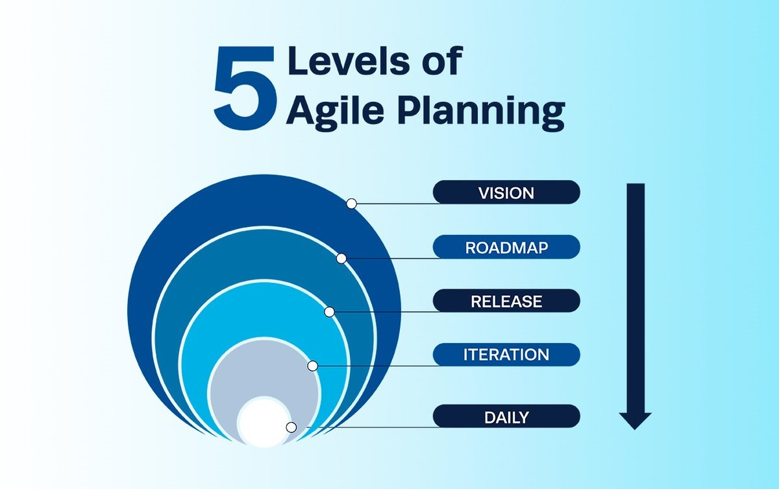
Development Background- Time Frame
We follow Agile planning, an iterative approach to managing projects that avoids the traditional concept of detailed project planning with fixed dates and scope. Rooted in the principles of the Agile Manifesto, Agile project planning emphasizes frequent value delivery, continuous end-user feedback, cross-functional collaboration, and ongoing improvement, making it much faster than the traditional software development process.
After conducting a critical analysis and feasibility study during the vision phase, we identified:
7500 tasks for the Recruitment module
9000 tasks for the HRMS module
7500 tasks for the Finance module.
Total 24000 tasks
Introduction
Recruitment
HRMS
Finance
Development Background
USP &CAC
Conclusion
12 of 20

Slide 13
Development Background- Time Frame
We define each sprint duration as 2 weeks. Based on our 10-member team and feasibility study, we have determined that we can complete 10 task cards per day. In 2 weeks, we have 12 working days (consider 6 working days in a week)
In a single sprint we will complete 10x120=1200 Tasks
Total 24000/1200= 20 Sprint
Duration based on total sprint 20x2= 40 Weeks
Considering 8 weeks for Backlog and Leave adjustment
Total 40+8= 48 Weeks (48/4= 12 Months)
Module wise break down
Recruitment:
7500/1200= 6 Sprint, 6x2= 12 Weeks, 12/4= 3 Months
HRMS:
9000/1200= 8 Sprint, 8x2= 16 Weeks 16/4= 4 Months
Recruitment:
7500/1200= 6 Sprint, 6x2= 12 Weeks, 12/4= 3 Months
Note: Though all the modules will develop together, this breakdown will help to identify module expense.
Introduction
Recruitment
HRMS
Finance
Development Background
USP &CAC
Conclusion
13 of 20

Slide 14
Development Background- Expense
Effective cost management is essential for the success of any software development project. By planning carefully, estimating costs accurately, monitoring expenses closely, communicating with stakeholders, and implementing cost-saving measures, we ensure our project is completed on time and within the budget. We consider 5 USD average hourly pay for each dev team members.
Task wise break down
Total hourly pay 5x10= 50 USD
Per day pay 50x8= 400 USD
200 USD per day cost for infrastructure and others
Total per day cost 400+200= 600 USD
Per month cost 600x30= 18000 USD
Cost for 12 months
18000x12= 216000 USD
Module wise break down
Recruitment:
Total 18000x3= 54000 USD
HRMS:
Total 18000x4= 72000 USD
Recruitment:
Total 18000x3= 54000 USD
Note: Keeping in mind that 10 tasks per day for 10 team members, as discussed in previous slide.
Introduction
Recruitment
HRMS
Finance
Development Background
USP &CAC
Conclusion
14 of 20

Slide 15
Integrated System Workflow
HRMS
Finance
Recruitment
Job Description
Online Job Posting
Job Applications
Resume Parsing
Budgeting
Payroll
Sales
Leave & Attendance
Off Time Tracking
Benefit Management
Training and Certification
Performance Tracking (Promotion & Increment)
Candidate Vatting
Interview Scheduling
Notification Alerts
Offer Letters
On Boarding
Candidate Database
Central Database
Cash Flow

Slide 16
Unique Selling Proposition USP
Our employee benefits feature is unique and is one of the core functions of the human resources module.
A comprehensive employee benefits package can help keep current employees satisfied, while competitive perks can attract and retain top talent in a tight labor market.
Using the unique employee benefits feature, the HR team can work efficiently and make data-driven decisions using AI, based on various parameters such as daily attendance, timecards, productivity, and more.
This will help identify the right employees who truly deserve promotions, salary increments, or special benefits.
Introduction
Recruitment
HRMS
Finance
Development Background
USP &CAC
Conclusion
16 of 20

Slide 17
Cost Per Customer Acquisition
Analyzing Customer Acquisition Cost (CAC) in conjunction with Lifetime Value (an estimate of how much revenue our account will generate over its lifetime by continuing to purchase or subscribe to our product) or Monthly Recurring Revenue (a measurement of revenue generated on a monthly basis) is a common way to assess whether cash flow is operating efficiently.
We determine that we have a sales team of 3 member and each member average per month is 600 USD
Total Sales team salary per month 600x3= 1800 USD
Advertisement cost per month (Online and other media) 300 USD
Development team per month cost is 18000 USD (from previous slide)
Total cost per month 1800+300+18000= 20100 USD
Introduction
Recruitment
HRMS
Finance
Development Background
USP &CAC
Conclusion
17 of 20

Slide 18
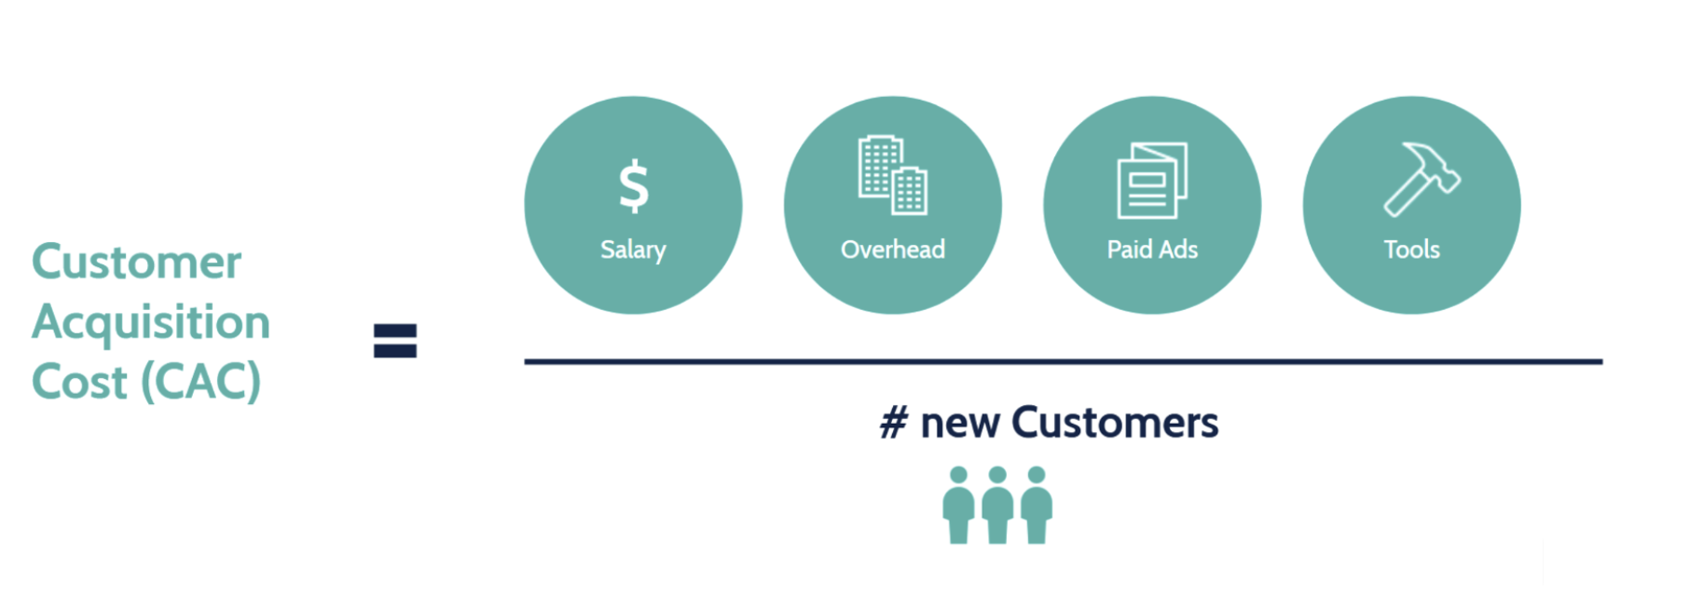
Cost Per Customer Acquisition- Calculation
We receive an average of 3 customers per month.
Our Cost Per Customer Acquisition is:
+
+
+
CAC = 20100/3= 6700 USD
Introduction
Recruitment
HRMS
Finance
Development Background
USP &CAC
Conclusion
18 of 20

Slide 19
Conclusion
As we've explored throughout this presentation, the Recruitment, HR, and Payroll software offered by TechForing is a comprehensive solution designed to streamline and enhance key human resources functions. By integrating advanced automation, data-driven decision-making, and user-friendly interfaces, our platform empowers organizations to efficiently manage the entire employee lifecycle from recruitment and onboarding to performance evaluation and payroll processing.
The implementation of the user-friendly and dynamic features of TechForing Growth software enables your HR department to drive better talent acquisition and retention, leading to a more engaged workforce. As we embrace this innovative solution, we are not only investing in the tools that enhance our HR capabilities but also in the long-term success and profitability of the organization.
Introduction
Recruitment
HRMS
Finance
Development Background
USP &CAC
Conclusion
19 of 20

Slide 20

Thank You!

